Slide 1
Bea Nemeth
3rd December 2021
Countdown to midnight on New Years Eve

Slide 2
The Task
letcurrentHours: number=23;
letcurrentMinutes: number=43;
letcurrentSeconds: number=45;
// Write a program that prints the remaining seconds from a
// day if the current time is represented by these variables
Caption

Slide 3

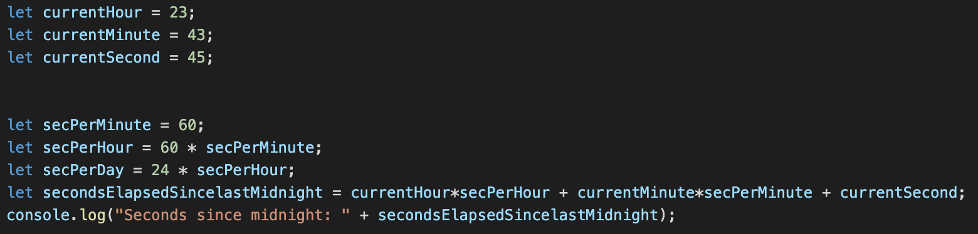

How to start????
Let’s calculate the total seconds per day and the seconds since last midnight!
Result in the Terminal:

Slide 4


Last Step
Decrease the total amount of seconds in the day by the seconds past since last midnight
Result in the Terminal:

Slide 5
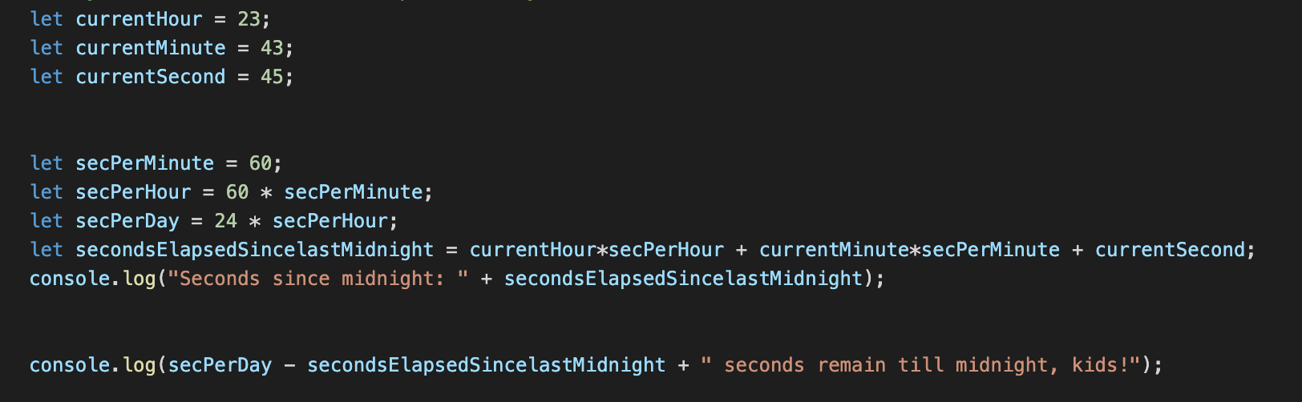
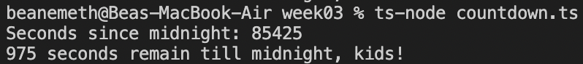
The whole program:
The result in the Terminal:

Slide 6
How to check if the result is correct?
Change the time to 23:59:50 :)

Slide 7
Thank you very much for your kind attention!

